Slide 1
CEO Roundtable
Operations in the 21st Century DOT
MEETING CUSTOMER EXPECTATIONS
Photo: © iStockphoto.com/George Doyle (200393312-001)

Slide 2
Why Are We Here?
Customer Needs and Customer Expectations
Technology Innovation and the Internet
Achievable Benefits in Lean Fiscal Times
National Goal to Improve Highway Efficiency/Safety
02
Photo: © iStockphoto.com/Alexey Stiop (100071322)

Slide 3
Customer Expectations Are Changing
Changes in the public’s expectations in their everyday lives are translating to changes in their expectations of government
Information is available 24/7 on mobile devices
Greater service reliability is expected
Less tolerance for delay
Productivity and efficiency gains in private sector
Greater accountability
Technology is driving many of these changes
03
Photo: © iStockphoto.com/Jupiterimages (86542073)

Slide 4
Technology Transforms Our World
Our customers are expecting changes in how we deliver service.
Wireless communications sweeping our planet
Internet connectivity to the entire cloud
Revolutionary expectations for productivity and efficiency
Value to the customer as the customer perceives technology drives every organization as never before
04
Photo: © iStockphoto.com/Pavel Ilyukhin (141575054)

Slide 5
Expectations of DOTs Are Changing
System reliability and safety are customers’ central demands.
System users require accurate, timely, and accessible information.
In lean times, DOTs can gain efficiency from “smart government” and the use of technology.
05
Photo: © iStockphoto.com/alubalish (20084140)

Slide 6
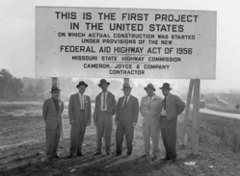
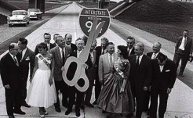
Build It
Photos: © iStockphoto.com/Wesley VanDinter (122886013); top inset, Federal Highway Administration; bottom inset, Wisconsin Historical Society (image no. 1873)
06

Slide 7
Renew It
Photos: © iStockphoto.com/Nikola Nastasic (131870908); top left inset, © iStockphoto.com/Milan Klusacek (97709432); bottom left inset, © iStockphoto.com/Dmitry Kalinovsky (134551232); bottom right inset, © iStockphoto.com/blyjak (18870043)
07

Slide 8
Operate It
Delivering your system’s benefits to your customers
08
Photo: © iStockphoto.com/Jean Schweitzer (139747439)

Slide 9
The Payoffs from Strengthened Operations
Alignment with customers
Safety for travelers
Efficient use of the existing system
Leveraging innovation and technology
Meeting customer needs!
09
Photo: © iStockphoto.com/Comstock (78458856)

Slide 10
Benefits of Operations
{
National Causes of Delay
Benefits of Operations Initiatives
Region-wide impact Prompt implementation High benefit and low cost Positive public response
40%
40%
30%
25%
20%
15%
10%
10%
5%
5%
0%
INCIDENTS
WORK ZONES
BOTTLENECKS
BAD WEATHER
SIGNAL TIMING
SPECIAL EVENTS
10
Photo: © iStockphoto.com/ben yong you (137958298)

Slide 11
Operations Opportunities
FROM EVERYDAY MAINTENANCE ACTIVITIES TO CUTTING EDGE INNOVATION
Smarter Maintenance Operations
Work Zone Management
Event Management
Traffic Signal Synchronization
Road Weather Information Systems
Traveler Information Systems
Ramp Meters, Lane Operations, and Control
Traffic Incident Management
11
Photo: © iStockphoto.com/Digital Vision (dv797002-1)

Slide 12
Smarter Maintenance Operations
Maintenance Decision Support Systems
A Proven, Cost-Effective Tool for State and Local DOTs
Photos: © iStockphoto.com/Jupiterimages (86521201); inset, © iStockphoto.com/BanksPhotos (20026694)
12

Slide 13
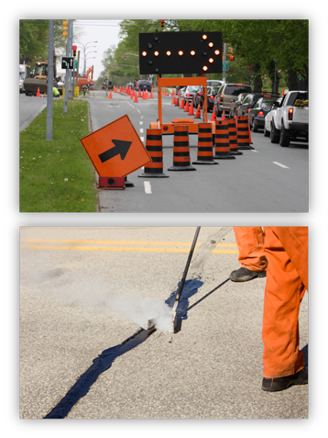
Work Zone Management
A state DOT used automated speed detectors in a three-mile interstate work zone. Updated message signs were used to distribute drivers to an alternate freeway.
19% decrease in ADT traffic at work zone
15% increase in ADT traffic on alternate freeway
Photos: © iStockphoto.com/Trevor Smith (117812988); top inset, © iStockphoto.com/Mike Clarke (6336691); bottom inset, © iStockphoto.com/BanksPhotos (16140025)
13

Slide 14
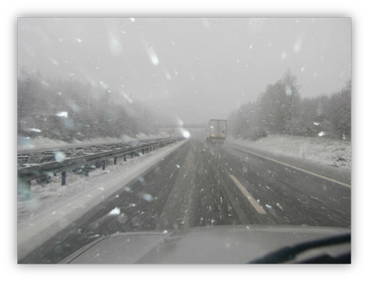
Road Weather Information Systems
A DOT installed a low visibility warning system.
Speed variability reduced 22%
Crash rates reduced 70 – 100%
A DOT wet pavement detection and advisory system reduced crashes by 39%.
Photos: © iStockphoto.com/Craig Neil McCausland (20673463); inset, © iStockphoto.com/Altrendo Travel (90206760)
14

Slide 15
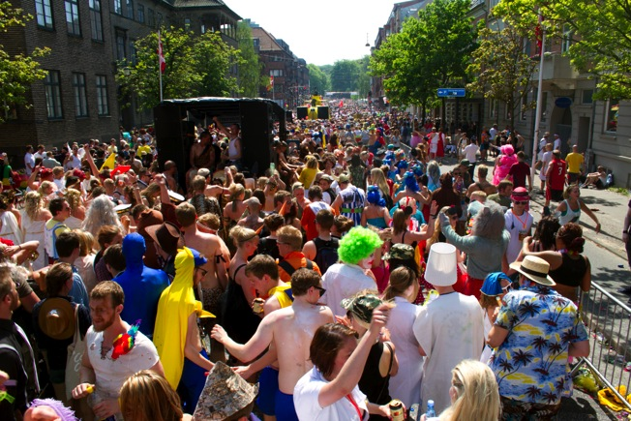
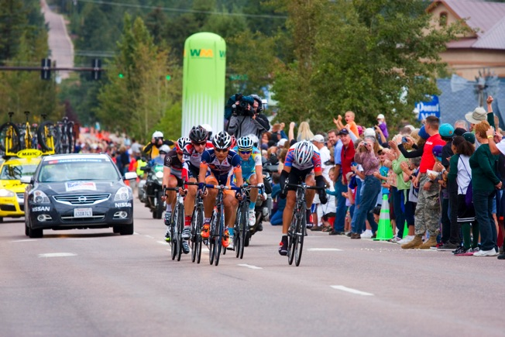
Event Management
Travel time to a major racing facility in Phoenix was reduced by over 70% by applying event management strategies.
Agency collaboration is important to effective event management.
15
Photos: © iStockphoto.com/Shane Michael (4519294); top inset, © iStockphoto.com/dennisjim (21410333); bottom inset, © iStockphoto.com/S.W. Krull (4519294)
14

Slide 16
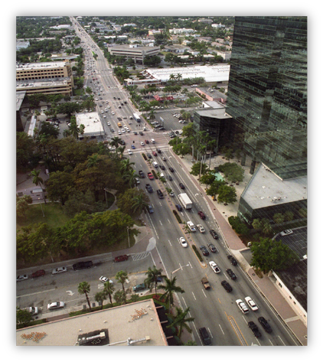
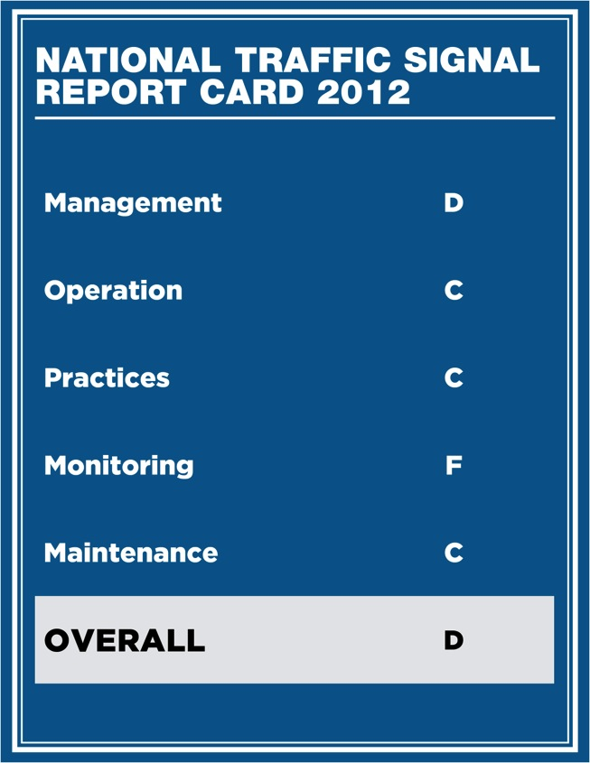
Traffic Signal Synchronization
Reductions in traffic delay ranging from 15-40%
Reductions in travel time up to 25%
Reductions in stops ranging from 10-40%
+
16
Photos: © iStockphoto.com/Comstock (78457390); inset, Kittelson & Associates, Inc.

Slide 17
Traveler Information Systems
Highway Advisory Radio
511 Traffic Conditions
Variable message signs
Radio and television traffic reports
Web-based traffic cameras
Commercial traffic condition and prediction services
Real-time trip times - 7.9% mode shift to transit for 20 minute time savings
Ramp closures and dynamic message signs during a holiday season - 50 percent reduction in traffic queues
17
Photo: Kittelson & Associates, Inc.

Slide 18
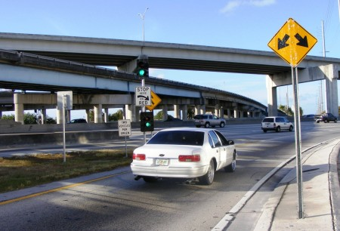
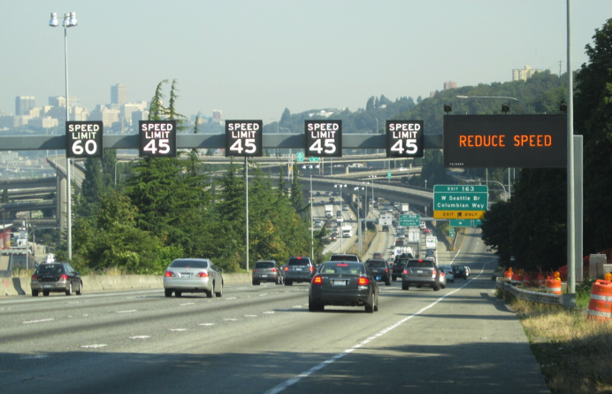
Ramp Meters, Lane Operations, and Control
Miami 95 Express Improved All Traffic |  | Before | After
Travel Speed (General Purpose Lanes) | AM | 20.3 | 60.9
 | PM | 18.1 | 48.5
Volume (All of I-95) | AM | 6,791 | 11,588
 | PM | 7,607 | 9,171
Transit Ridership | Daily | 1,746 | 4,286
Photos: © iStockphoto.com/Mark Hatfield (137316743); left and top right insets, courtesy of Florida Department of Transportation; bottom right inset, courtesy of Washington State Department of Transportation
18

Slide 19
Safety Service Patrols/ Incident Response Trucks
Specially equipped response trucks and trained operators
Assisting stranded motorists and clearing debris
Traffic control during traffic incidents
Favorable public response
Service patrols cleared 80% of incidents within ten minutes.
$1.25 million program cost returned $9.8 million to citizens and businesses.
19
Photo: Courtesy of Florida Department of Transportation

Slide 20
Traffic Incident Management
Proportion of Segment Capacity Available Under Incident Conditions
Number of Lanes | Shoulder Disablement | Shoulder Crash | One Lane Blocked | Two Lanes Blocked | Three Lanes Blocked
2 | 95% | 81% | 35% | 0% | 0%
3 | 99% | 83% | 49% | 17% | 0%
20
Photo: © iStockphoto.com/hereswendy (16131368)

Slide 21
Connected Vehicles
Vehicles “reading” the roadway and one another
Collisions reduced; reliability improved
Smarter and cheaper operations and maintenance
Pilot studies on 5.9 GHz Communication spectrum begins in August
Technology transformation changes mobility
Image: Michigan Department of Transportation, Connected Vehicle Update, October 2011, Vol. 4, No. 1, courtesy of U.S. Department of Transportation
21

Slide 22
The Path to Excellence in Operations for a State DOT
To Here
What areas should this DOT
target for improvement?
Which capabilities does the
DOT have to improve to get there?
From Here
22
Photo: © iStockphoto.com/Jupiterimages (86522038)

Slide 23
How to Move Forward
What are your customer’s expectations?
Who is responsible for managing operations?
Where are you today?
Where do you want to go?
How are you going to get there?
23
Photo: © iStockphoto.com/seraficus (118347093)

Slide 24
These Areas Need Your Focus
Scope
Business Processes
Systems/ Technology
Performance Measurement
Culture
Organization/Staffing
Resource Allocation
Partnerships
24
Photo: © iStockphoto.com/Johnny Greig (19953920)

Slide 25
What Training Tools Are Available Now?
One-Day Workshop at Your State DOT to Evaluate Eight Organizational Dimensions and to Develop Improvement Strategies
Specialized Incident Management Techniques for Managers and Responders
AASHTO Guidebook for Systems Operations & Management
25
Photo: © iStockphoto.com/Maciej Korzekwa (92972777)

Slide 26
What Training Tools Are Available Now?
Operations Opportunity States Initiative
Operations Workshops
Planning for Operations
Localized Bottleneck Reduction
Managed Lanes
Work Zone Traffic Analysis and Guide
Performance Management/Measurement
Online / Webinar
Real-Time System Management Information (1201 Rule)
Strategies for Developing Work Zone Traffic Analyses
Principles of Evacuation Planning
Weather-Responsive Traffic Management
26
Photo: © iStockphoto.com/Maciej Korzekwa (92972777)

Slide 27
What Training Tools Are Forthcoming?
Five-day Regional Operations Forum for hands-on staff training on operations concepts
Guidebooks, e-tools and web applications address:
Cost-effectiveness of design features that improve reliability
Incorporating reliability concepts into planning and programming
Improvements to the Highway Capacity Manual
Data collection and modeling
Best approaches to provide traveler information
27
Photo: © iStockphoto.com/Zoonar RF (126814493)

Slide 28
Next Steps?
Demonstrate commitment and involvement at the top level.
Empower the people who can make it happen and give them the resources they need.
Provide top-down direction and insist on bottom-up accountability.
28
Photo: © iStockphoto.com/Andrey Zyk (92246334)

Slide 29
Ask for Help
Contact AASHTO to arrange for a conference call or meeting to discuss needs and available assistance
Staff available from AASHTO, FHWA and TRB to participate
Schedule a follow up one-day Operations Opportunity Workshop
Develop a baseline, identify gaps/needs, develop a draft version of the action plan
29
Photo: © iStockphoto.com/Andrey Zyk (92246334)

Slide 30
Where Is Support Available?
30
Photo: © iStockphoto.com/David De Lossy (200225959-001)

